Slide 1
Back to the Future of Green Powered Economies
Juan Moreno Cruz* M. Scott Taylor **
*Georgia Institute of Technology
**University of Calgary, NBER
April 2016

Slide 2
Research Question
How did the movement in England circa 1600, from wood to coal, affect the location of population and economic activity?
&
What can this earlier transition tell us about our Future with Renewables?

Slide 3
Plan of Attack
Show how access to energy could affect population sizes.
Theory as the lens to view economic history.
Formally evaluate the effect of coal.
Use the model and empirics to guess about the Future.

Slide 4
Literature Review
Economic History:
Allen (2009), Smil (2006), Hatcher (1993), and Wrigley (2010).
Economic Geography:
Von Thunen (1826), Fujita, Krugman and Venables (2000), Davis and Weinstein (2002), Nunn and Qian (2011). Redding, Sturm and Wolf, (2011)
Resource/Energy Economics:
Severnini (2012), Gutberlet (2012), Gaudet (2001), Kolstad (1994), Chakravorty (1994), Moreno-Cruz and Taylor (2012).

Slide 5
Geography, History &
The Three Challenges

Slide 6
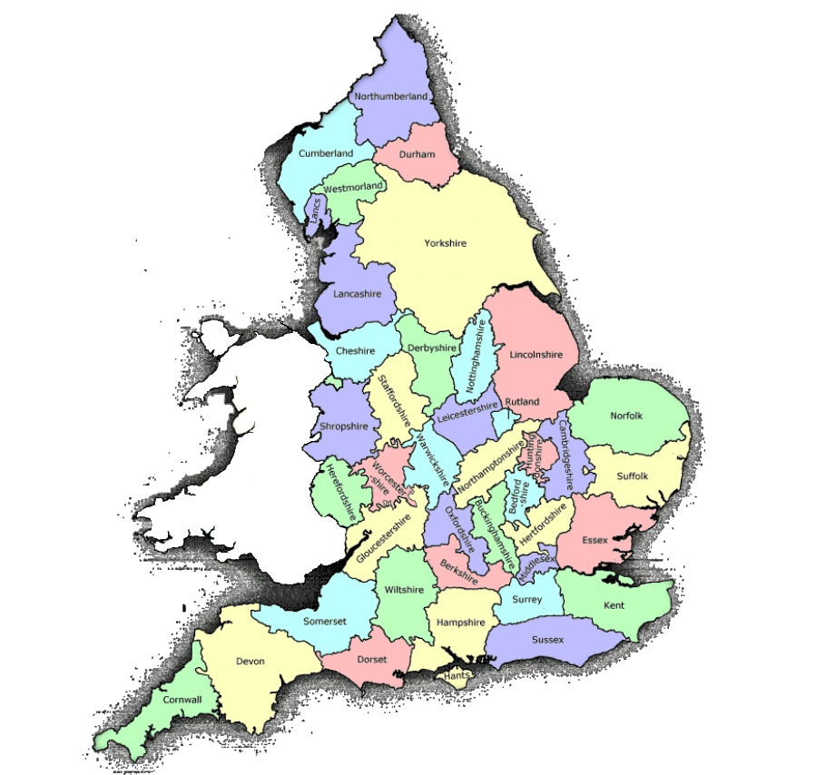

Slide 7
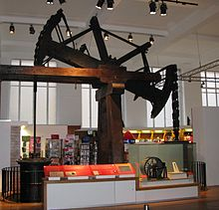
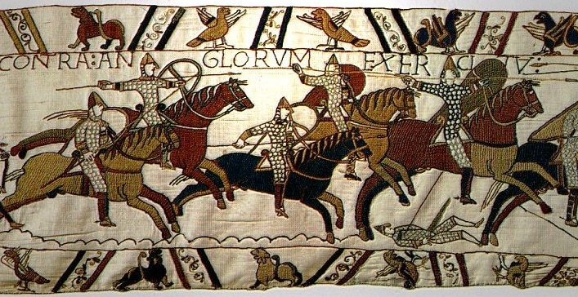

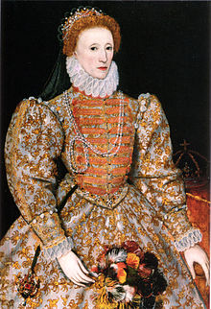
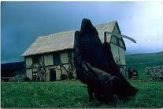
Population of England: 1086-1801

Slide 8
Population Densities

Slide 9
Population Rank: 1086 vs. 1801

Slide 10
The Three Challenges
Why did the population explode after 1600?
Why are the population density distributions the same up to 1377, and then different?
What caused the great reshuffling?

Slide 11
Theory
Increasing Returns,
Transport Costs, and
Malthusian Population dynamics

Slide 12
Important Simplifications
No distinction between Food and Fuel energy
No intraregional trade across counties.
No international trade.
No real investment decisions.

Slide 13
Tastes, Technology, Endowments
Utility function:
Final goods production:
Y=C+T

Slide 14
Intermediates
Intermediate production:
Activity production
Endowments
L fixed

Slide 15
The Demand for Energy
Add up factor demands over n firms, equate labor demand to supply, and find:

Slide 16
The Supply of Energy
Assume one unit of final good is paired with each unit of energy used in transportation
Ownership of resources is atomistic.
Energy resources are distributed in a two dimensional plane.

Slide 17
The Supply of Energy
Energy supplier’s optimization problem:
Solution:
Define s as the share of energy costs in extracting and transporting. Then:

Slide 18
These Assumptions Deliver
Complementarities in energy delivery system generate aggregate increasing returns.
Energy is essential in production
Rising marginal cost of energy

Slide 19
Consumption per-capita profile

Slide 20
Two less obvious results from Spatial setting
Scaling law
Low cost transport given by Rivers and Roads work exactly like productivity improvements.

Slide 21
Unique General Equilibrium
(if IRS bounded)
Energy extracted and supplied:
Exploitation Zone:

Slide 22
Area of Exploitation with a River

Slide 23
Area of Exploitation with a Road

Slide 24
Energy Supply via Roads, Rivers and Canals
Rivers:
Roads:

Slide 25
Consumption per-capita profile

Slide 26
Assumptions: Malthus
Births rise, and deaths fall, with consumption per capita
Death rates are higher in dense cities, because of poor sanitation, infectious disease, violence.
Steady state supply of population to a location is upward sloping.

Slide 27
Malthus plus energy constraints

Slide 28
Assumptions: Migration
Migrants sort to equalize expected (steady state) lifetime consumption across locations; its costless to move.
Steady state features constant flows of new entrants and exits across locations.
Steady state supply of population to a location is still upward sloping.

Slide 29
3-County example with Migration

Slide 30
History through the Lens of Theory

Slide 32
Initial periods distributions {1086, 1290, 1377} should be similar since fruits of nature fixed over time.
Black Death loosened the strength of agglomeration forces and hastened the end of serfdom.
Population can now migrate across counties.

Slide 34
Migration to London pushes population in the 1500s well past ability to use only firewood as energy.
Middlesex accesses cheap Northeast coal and undergoes an energy transition.
Information regarding coal’s use flows back to the other counties from return migration of workers, apprentices, and service workers.

Slide 36
Remaining counties are “treated” with the knowledge of coal’s uses and usefulness.
Counties with easy access, exploit it, and expand relative to those with more costly access.
Coal counties leapfrog others creating the great reshuffling.

Slide 37
Formal Empirics

Slide 38
Empirical Strategy
Counties with coal are “treated”
Counties without coal are “control”
Treatment is the spread of knowledge and techniques to use coal deposits.
Treatment comes from transition in Middlesex in 1500s.
Since population growth caused the transition in Middlessex it is excluded.
The use of coal elsewhere causes population growth in those counties.

Slide 39
E.S. Details
Impact of coal identified by across county and over time variation.
Investigate a binary indicator {coal, no coal} ; a share of county covered in coal indicator; and binary indicators reflecting those directly and indirectly treated by imports.
County f.e. and across England time fixed effects; controls for port access and road access pre-coal; controls for textile production; errors clustered by region of England x time.

Slide 40
The Data
Population data on 39 English Counties in the years {1086, 1290, 1377, 1600, and 1801}.
Census data plus manorial accounts, parish registers, muster rolls, bills of mortality, etc.
Data on rivers, existing (Roman) roads, roads existing at Domesday census, canal and river navigation acts.
Data on location of coal reserves, quality of them, some production and shipment data.
5 data points X (39-1) Counties = 190 obs.

Slide 41
Empirical specification
Our baseline specification is:
Coal indicator: binary, exposed coal/total area.
ϒ, ρ, time and county fixed effects
X_{i} controls: port, road, region.

Slide 42
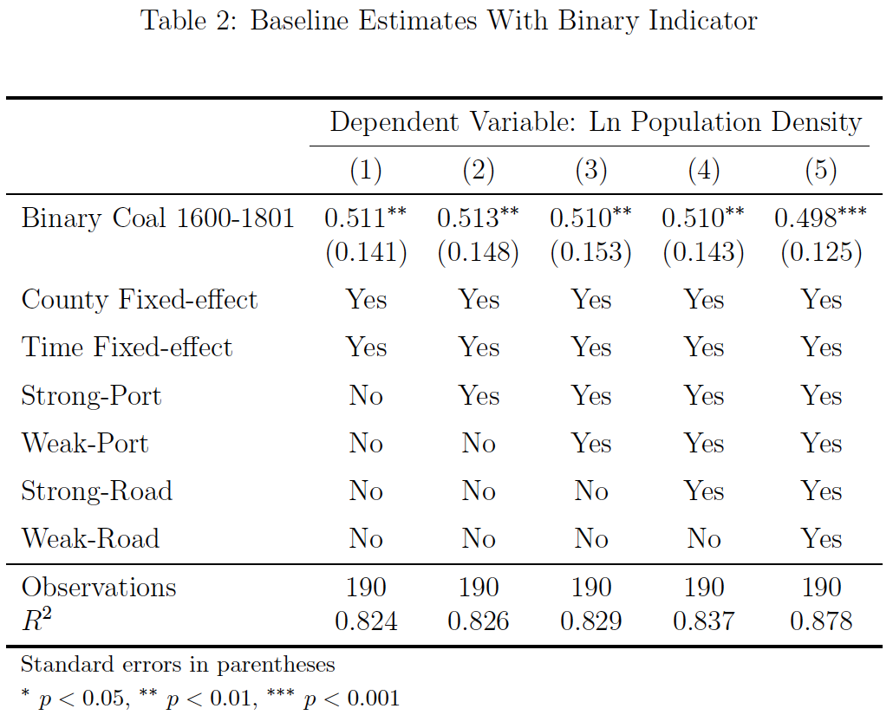

Slide 43
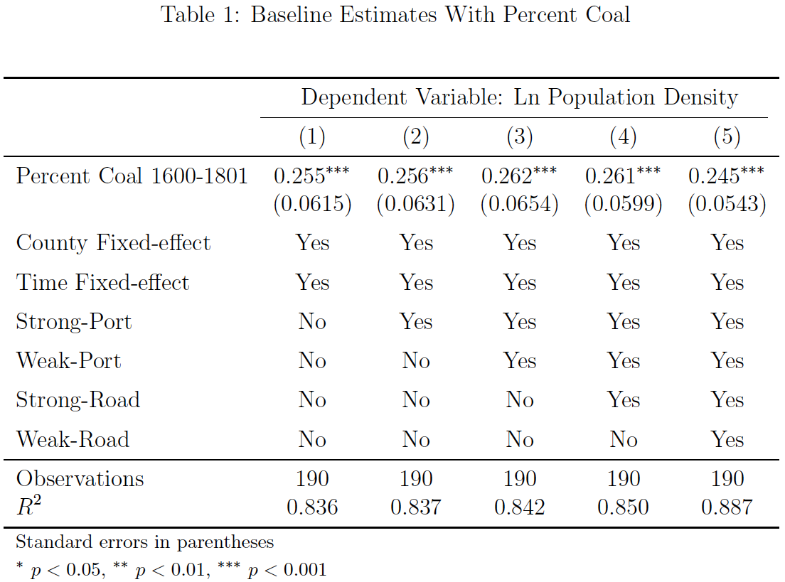

Slide 44
The Three Challenges
Why did the population explode after 1600?
Why are the distributions of population densities the same and then different?
What caused the great reshuffling?

Slide 45
Share of Growth attributed to Coal

Slide 46
The Three Challenges
Why did the population explode after 1600?
Why are the distributions the same and then different?
What caused the great reshuffling?

Slide 47
1086

Slide 48
1801

Slide 49
1801 – Counterfactual

Slide 50
The Three Challenges
Why did the population explode after 1600?
Why are the distributions the same and then different?
What caused the great reshuffling?

Slide 52
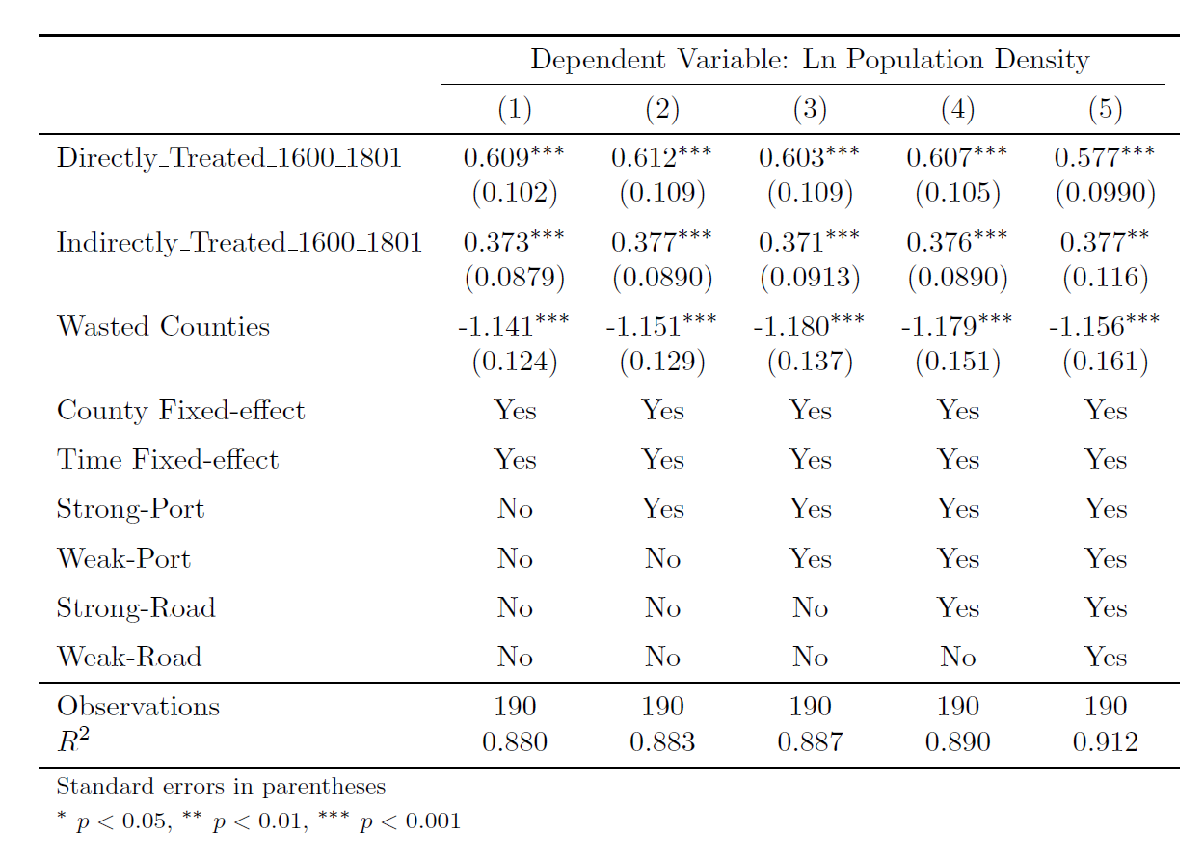
Table 3: Baseline Estimates with Direct and Indirect Indicators

Slide 53
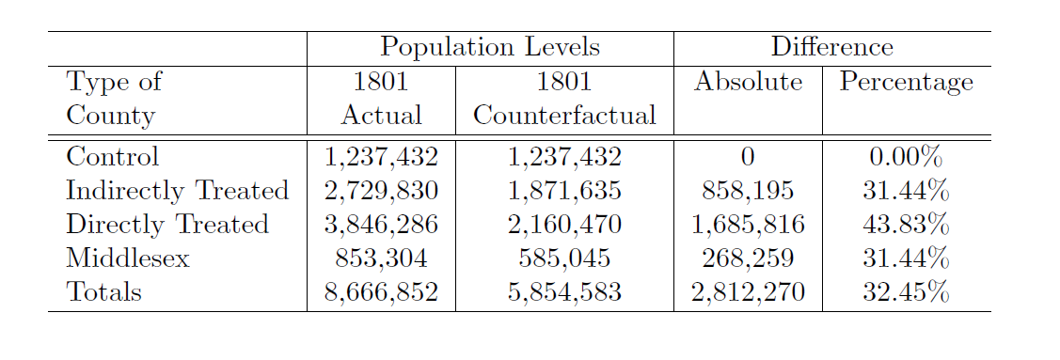
Table 4: Counterfactual Population of England

Slide 54
What about the Future?

Slide 55
Back to the Future?

Slide 56
Back to the Future:
Three Conditions
Renewable sources are often not placed near existing centers.
Transport of renewables is costly. Costly because of diffuse sources, and costly because lack of storability means costly to match supply and demand.
Energy is still important to the location of production and real incomes. Success of fossil fuels has masked their importance.

Slide 57
Conclusion
Energy can be very important to the location of economic activity and population.
Shifts in energy sources can create large incentives for redistributions in population and economic activity.
Tomorrow’s energy transition may be accompanied by strong pressures for industrial relocation and city downsizing.

Slide 58
Extra Slides

Slide 59
Robustness Checks
Extend time period
Exclude other counties near Middlesex
Include Textile region control
Use information about distance to coal
Allow for differential impacts for those directly and indirectly treated.

Slide 60
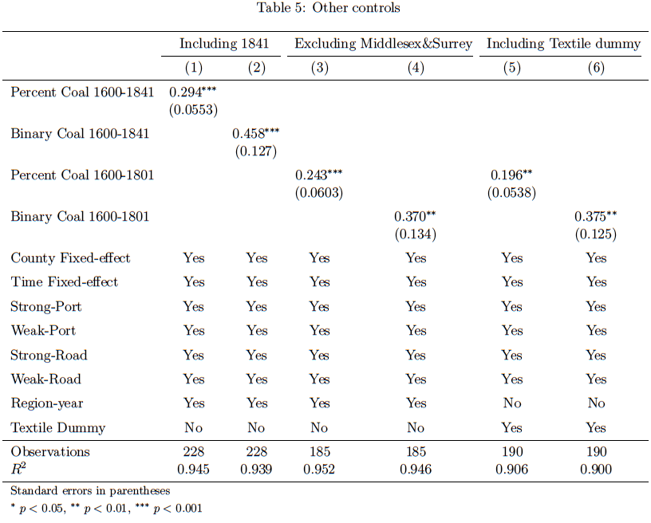

Slide 61
The Investment Boom
From 1650 onwards there was a rapid build up of transportation to move coal.
The canal binge peaked in later 1700s, with the last major canal built in 1840.
Railroads eventually took over from canals for inland transport.

Slide 62
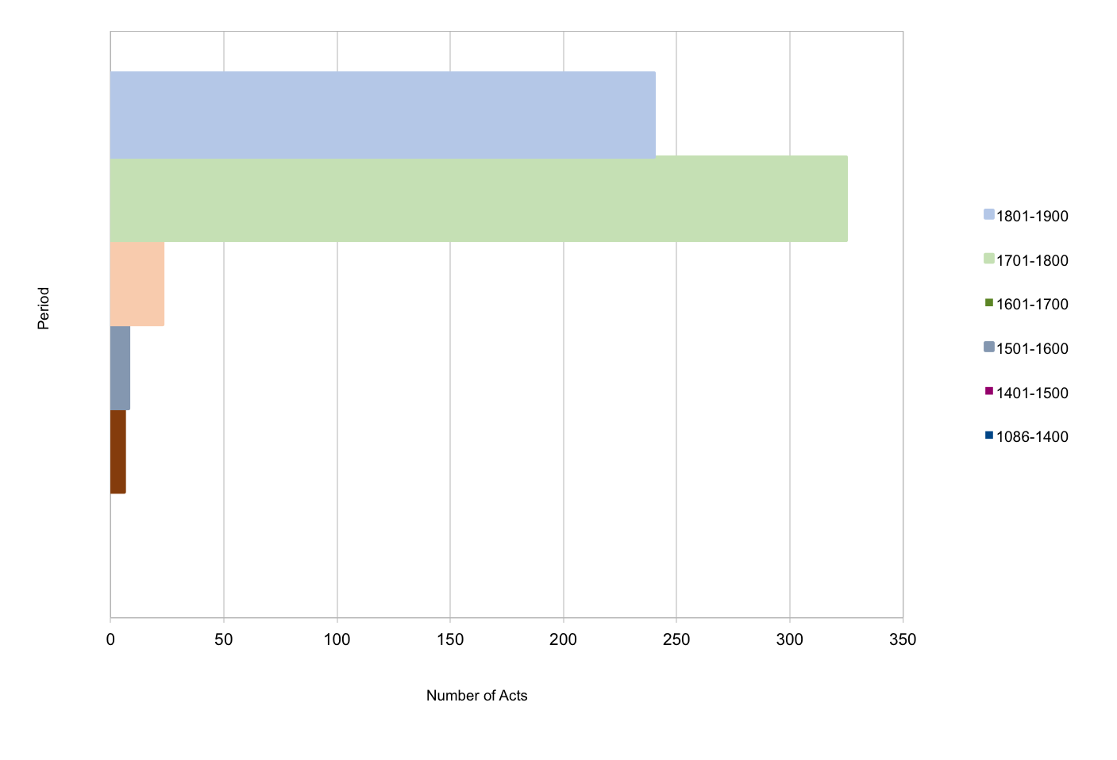
The Investment boom

Slide 63
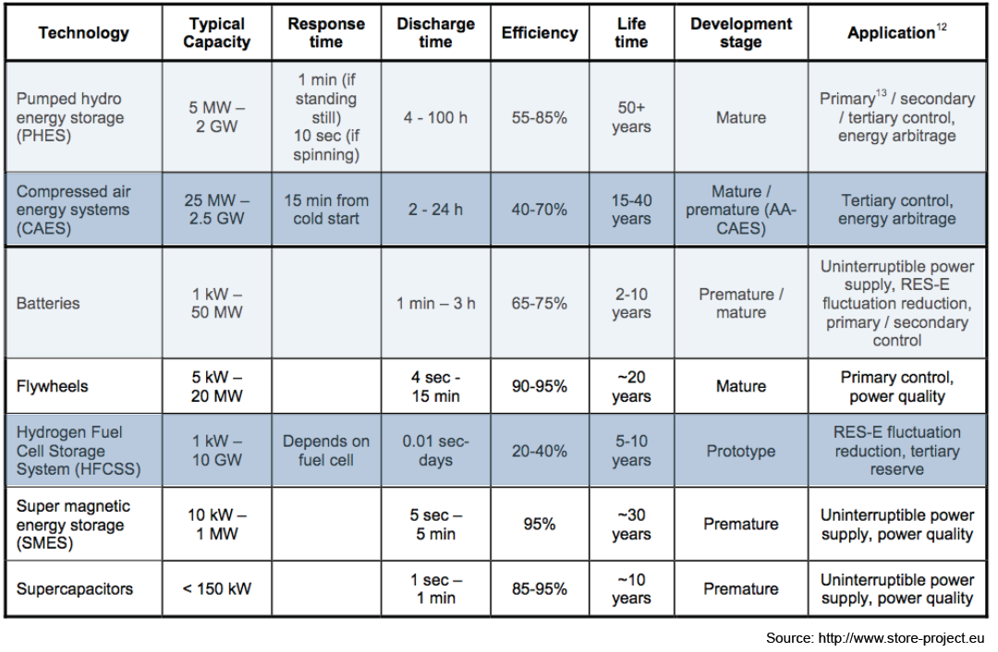
Fluctuations in RE production
Energy storage capacity

Slide 64
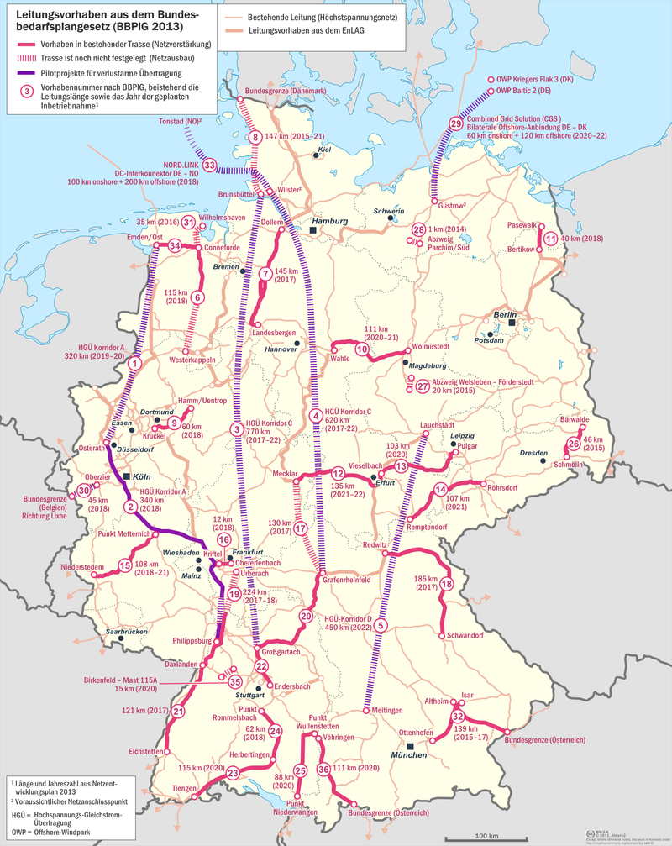
Congestions

Slide 65
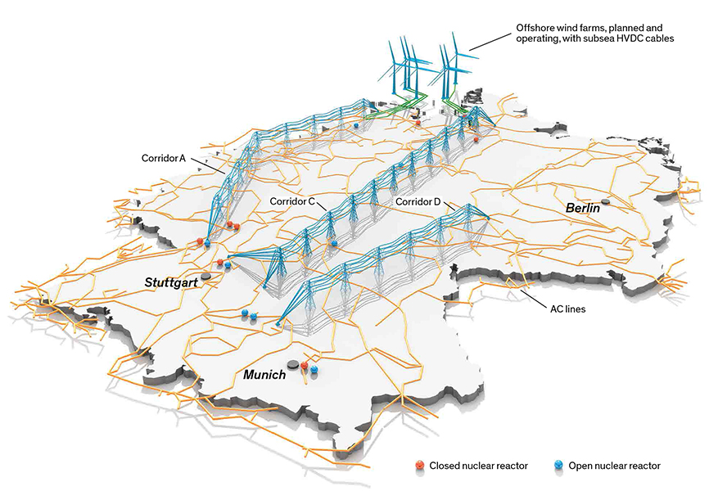
3.2. Congestions
Source: IEEE

Slide 66
Why 1500?
1500s London features very bad air pollution
Regulations against coal use;
Industry groups moving to coal; coal burning houses built.
1600 onwards coal per person London is static; relative prices are flat too.
1600 onwards in rest of country sees coal per person growing at rapid rates to catch and then surpass London.
Apprentices are likely carriers of information.

Slide 67
Evidence on location and timing
1500s London features very bad air pollution
Regulations against coal use;
Industry groups moving to coal; coal burning houses built.
1600 onwards coal per person London is static; relative prices are flat too.
1600 onwards in rest of country sees coal per person growing at rapid rates to catch and then surpass London.

Slide 68
Evidence on the transmission mechanism
No smoking gun, but…
Apprentices are likely carriers of information.
Service workers transmit info too
Evidence they came from all over England, and went back all over England.
1/6 or more of the population spent some time living in London in this era.

